Slide 1
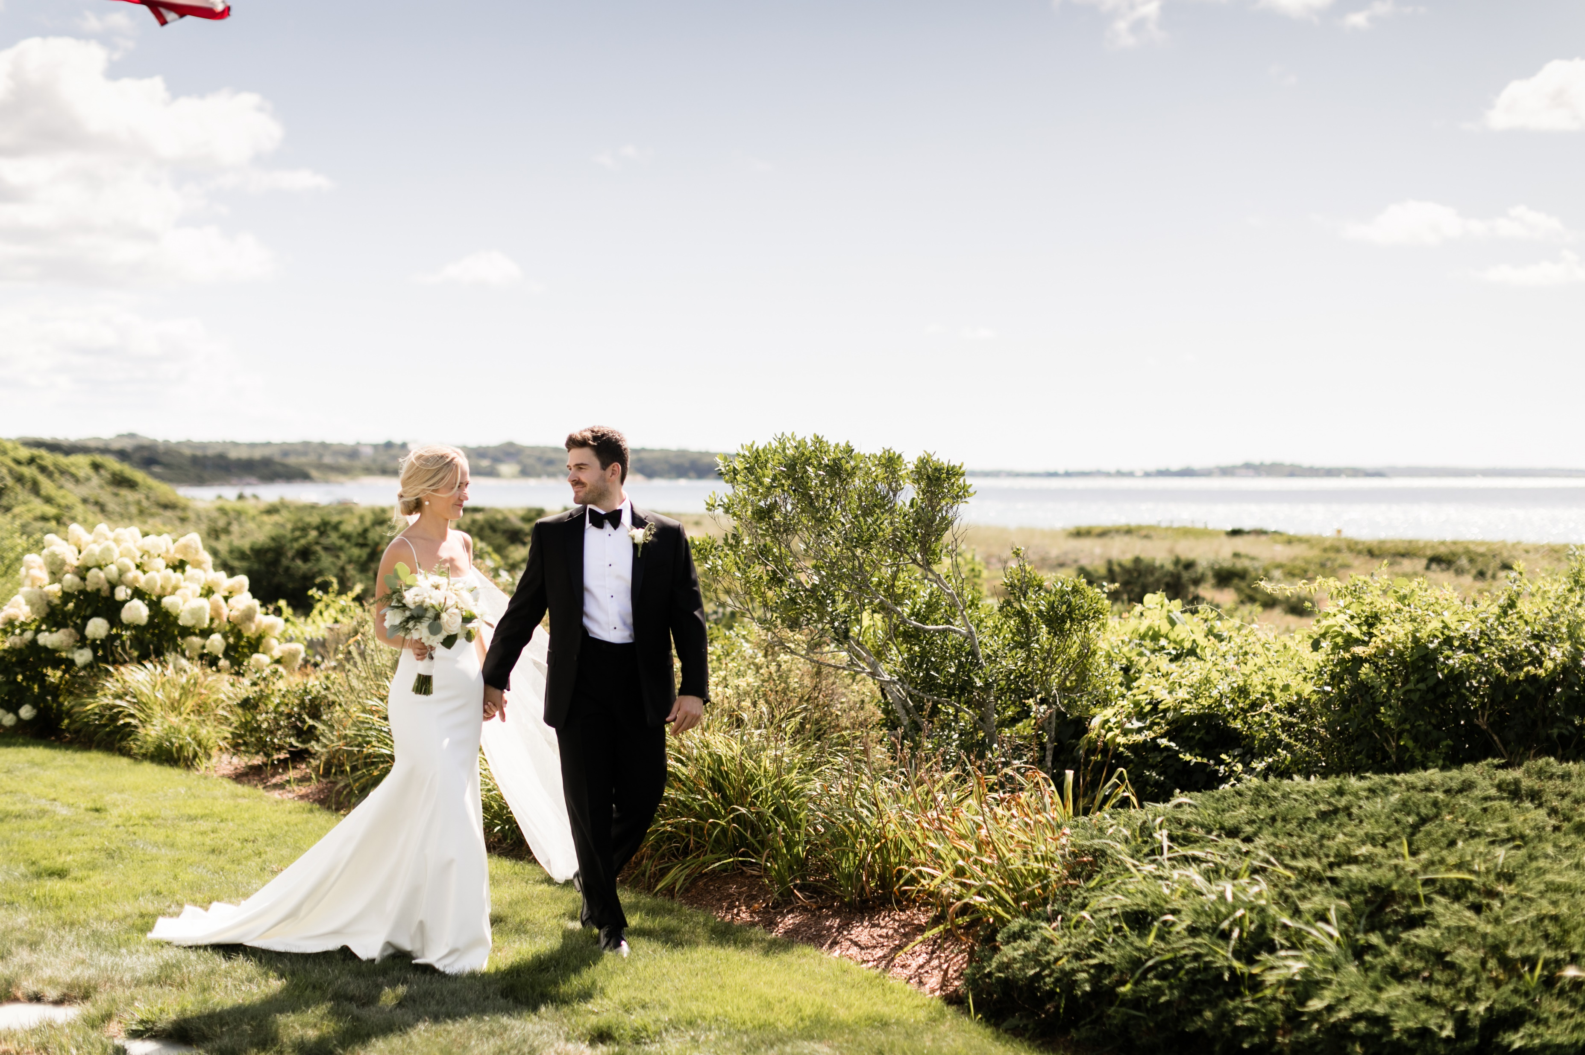
THANK YOU
the Falcos

Slide 2
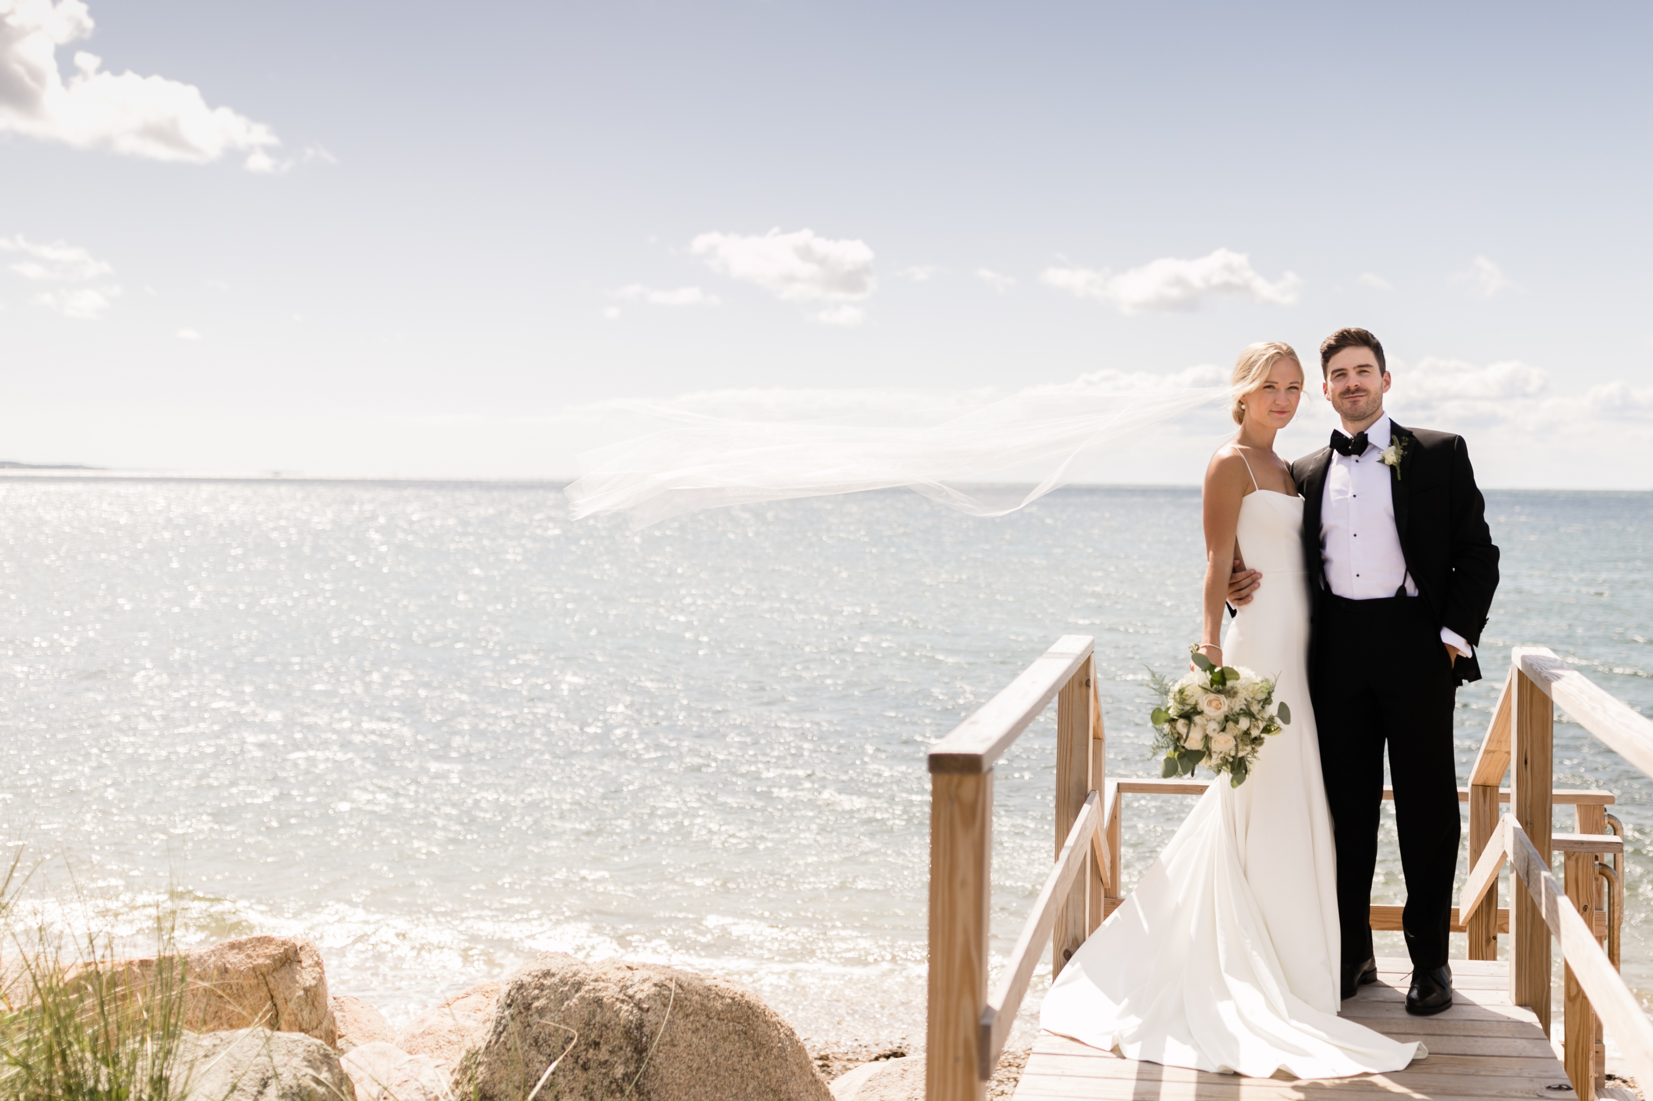
HAPPY HOLIDAYS
the Falcos

Slide 3
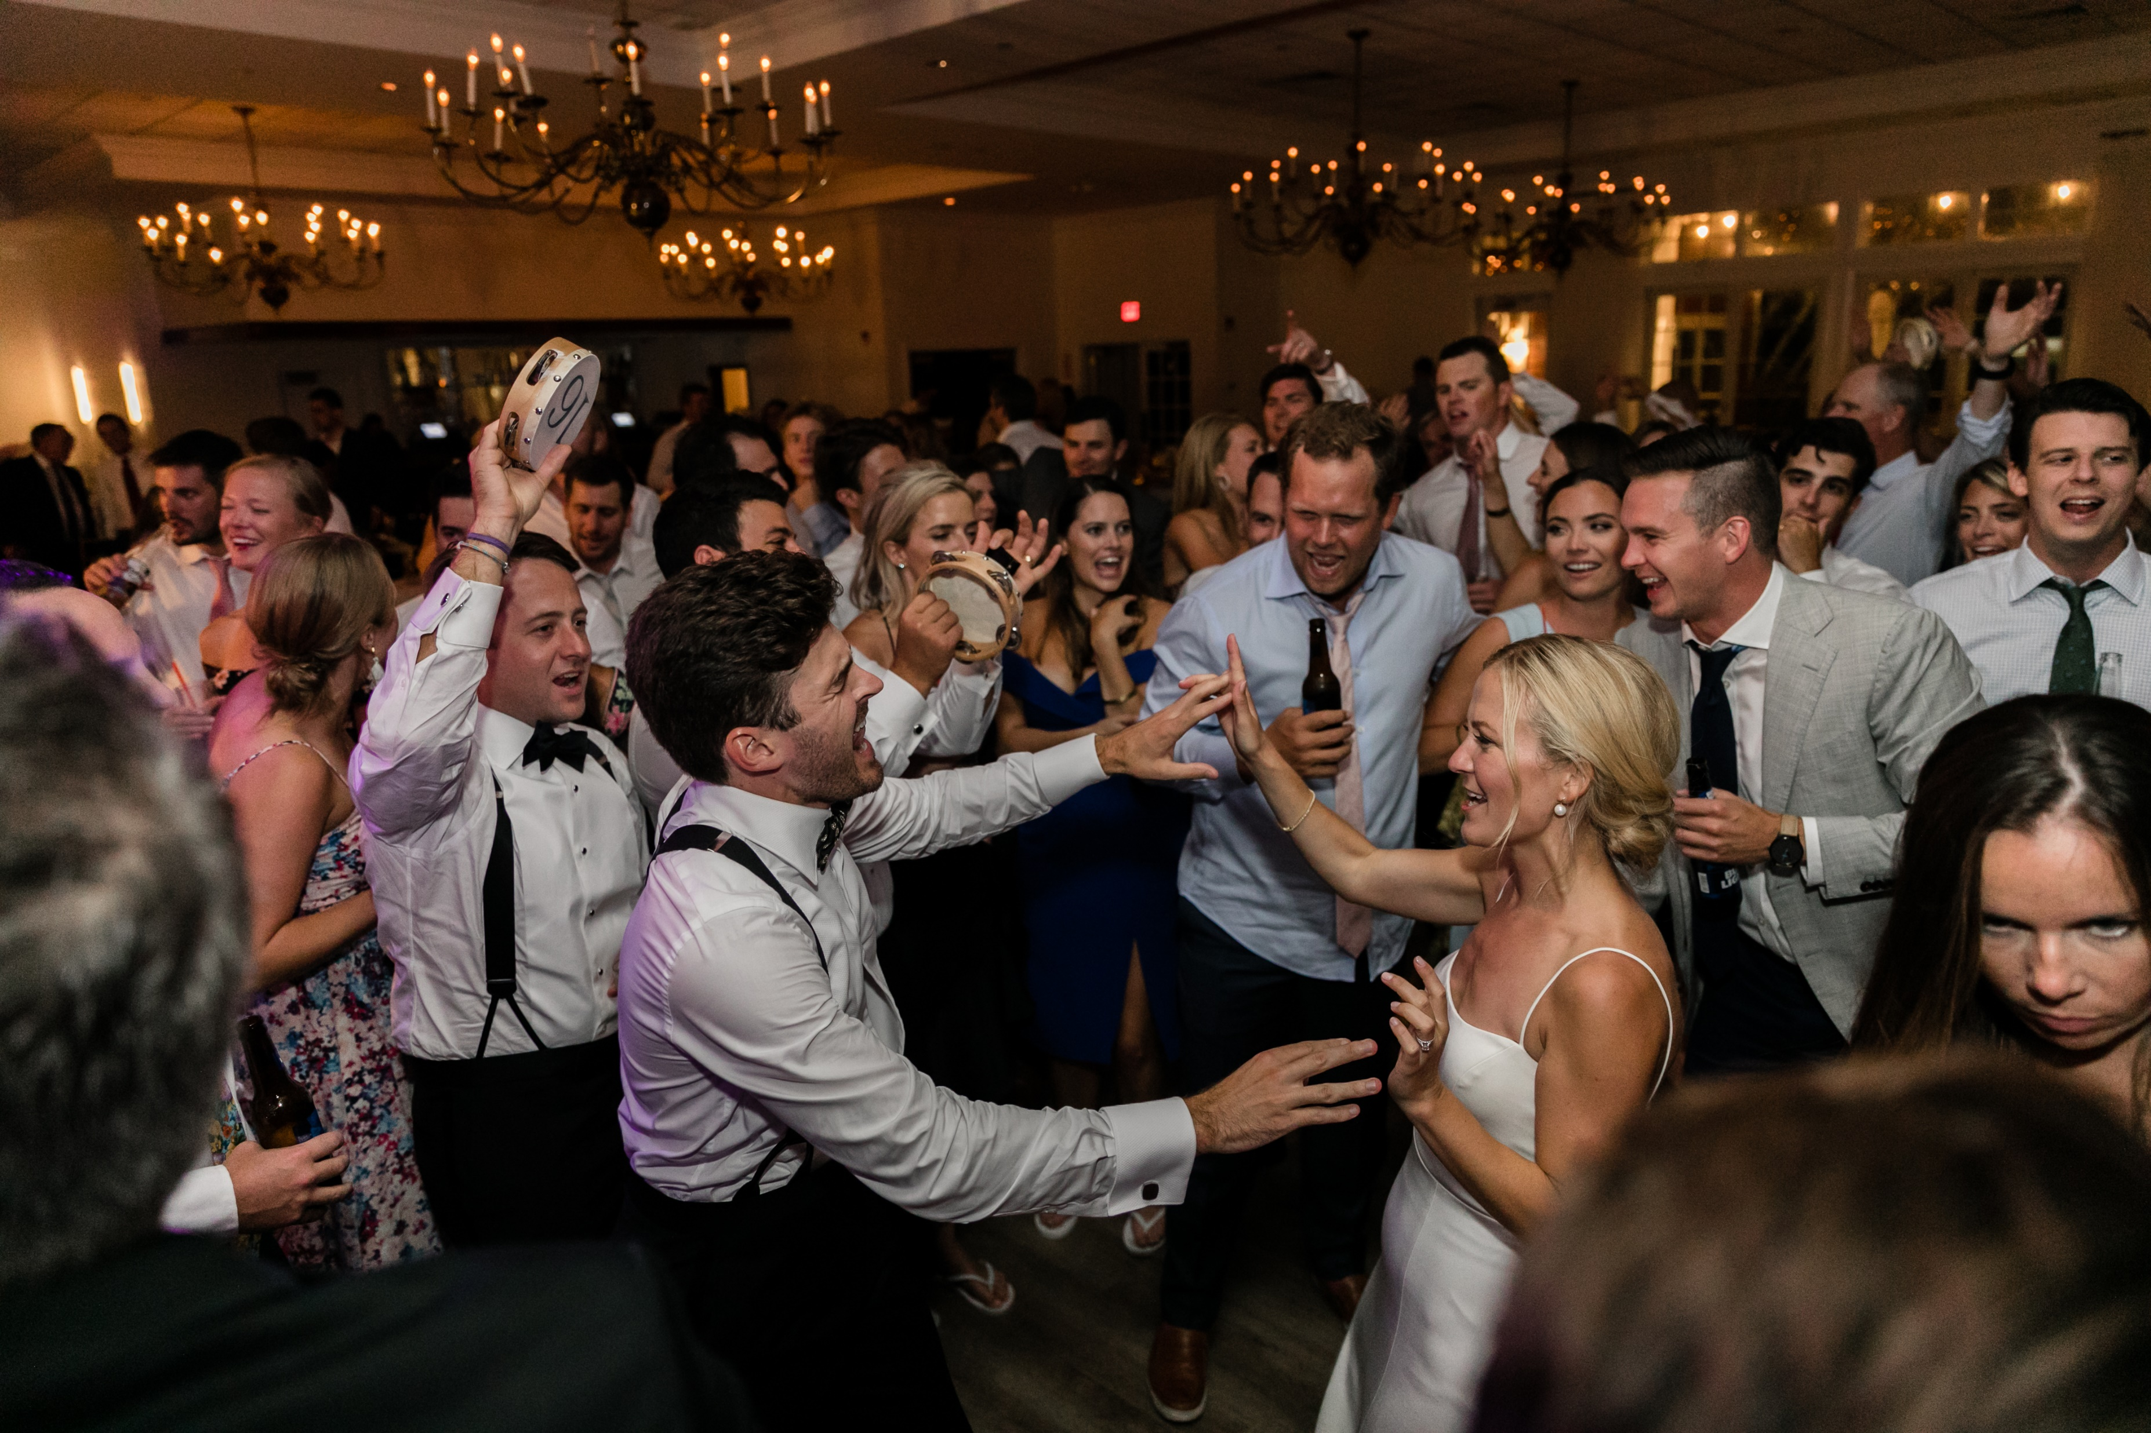
HAPPY NEW YEARS
the Falcos

Slide 4
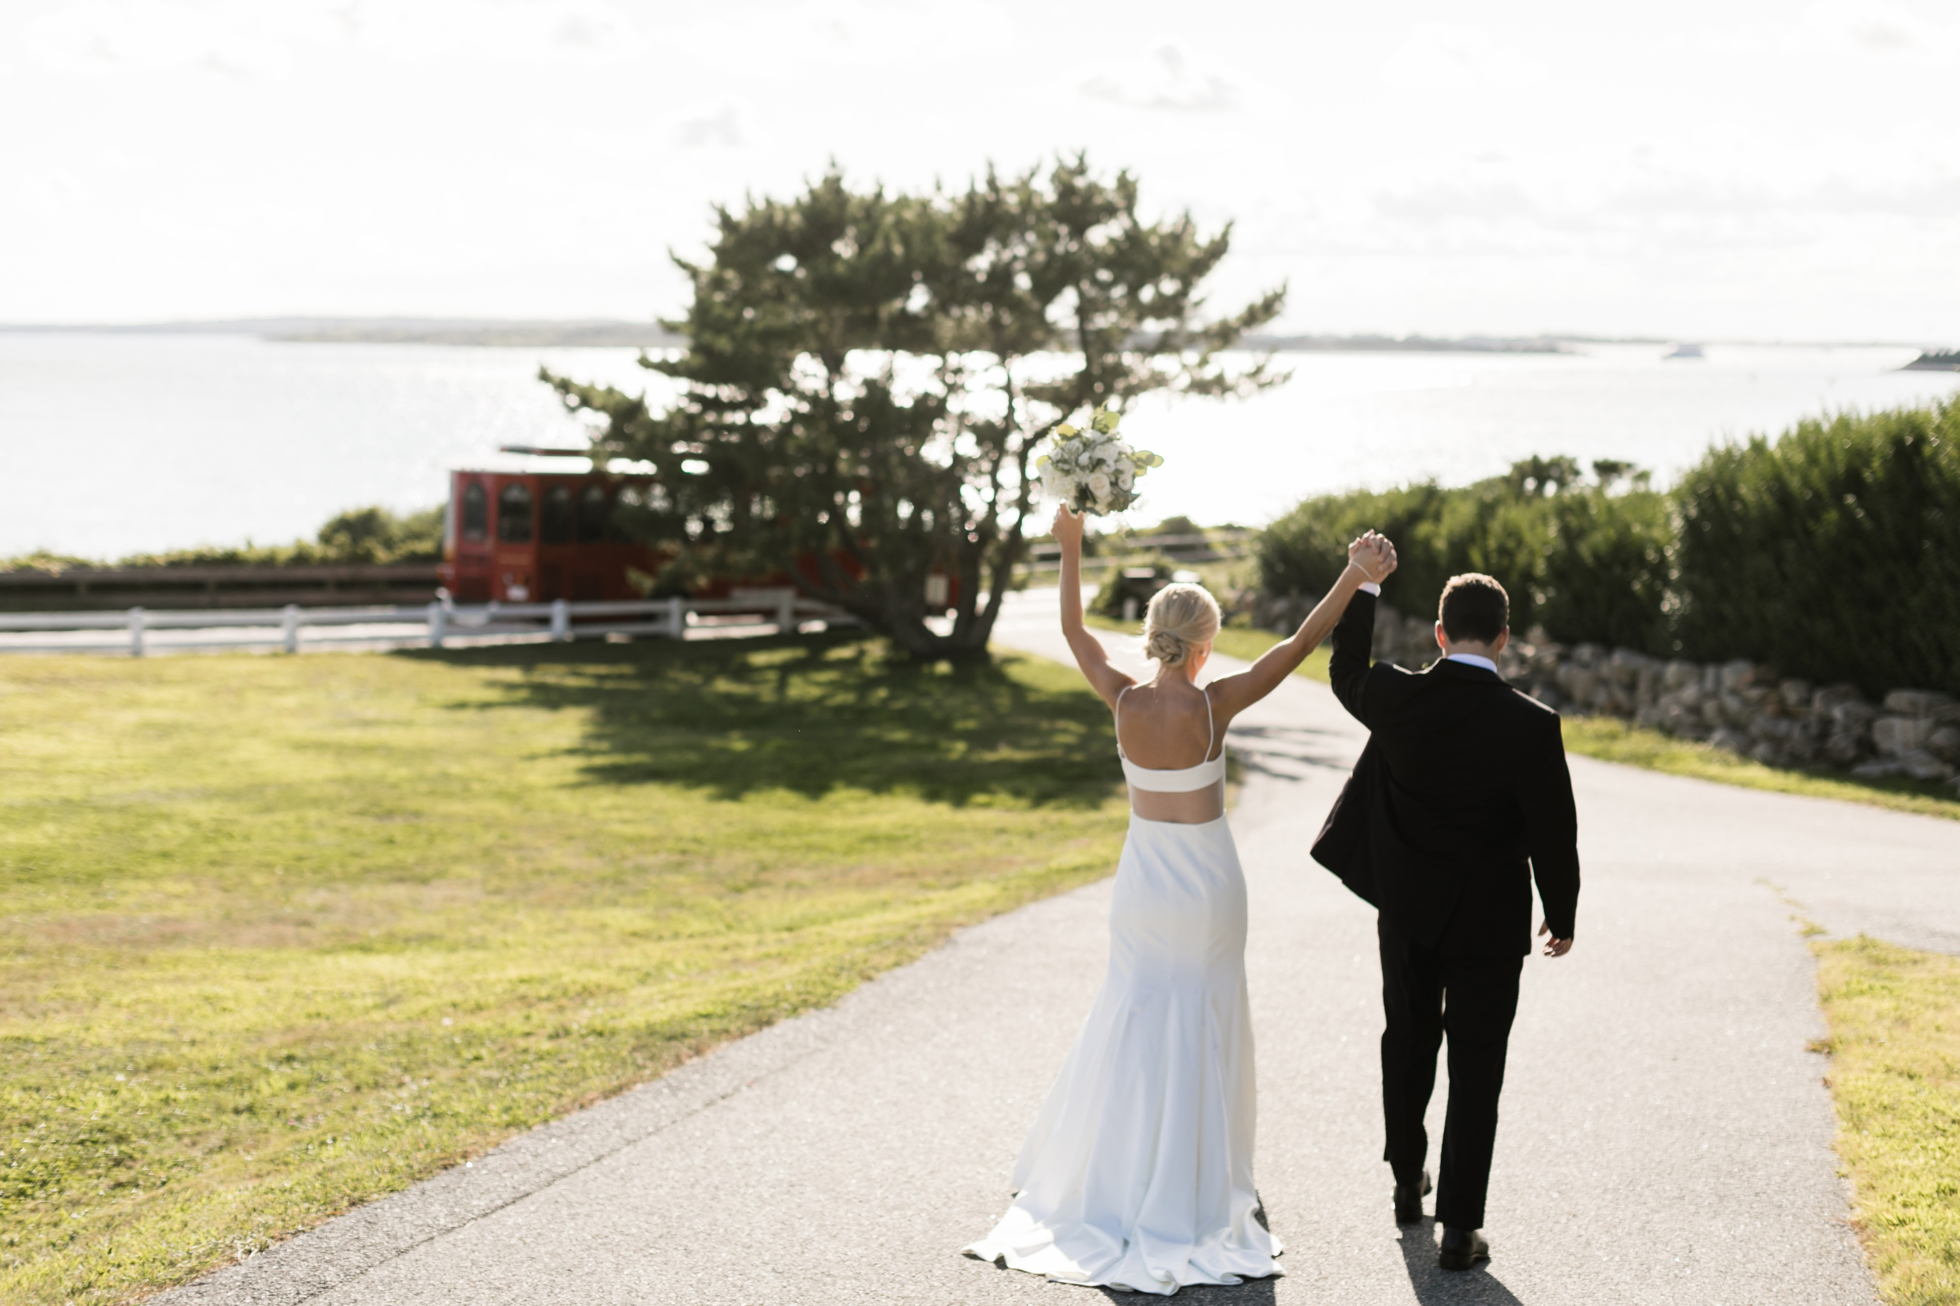

Slide 5

THANK YOU

Slide 6
THANK YOU
the Falcos

Slide 7
